Slide 1
Szemerédi’s Theorem and Arithmetic Progressions with Differences from a Random Set
Jason Zheng
April 2024

Slide 2
Acknowledgements
This talk is based on research conducted in the Fall 2023 semester at the University of Michigan, under the supervision of Dan Altman, in Math 499: Independent Study. I would like to acknowledge and thank my advisor.

Slide 3
Content
Background
Sizes of Random Sets
Statement and Outline of Proof

Slide 4
Background
Jason Zheng
July 14, 2022

Slide 5
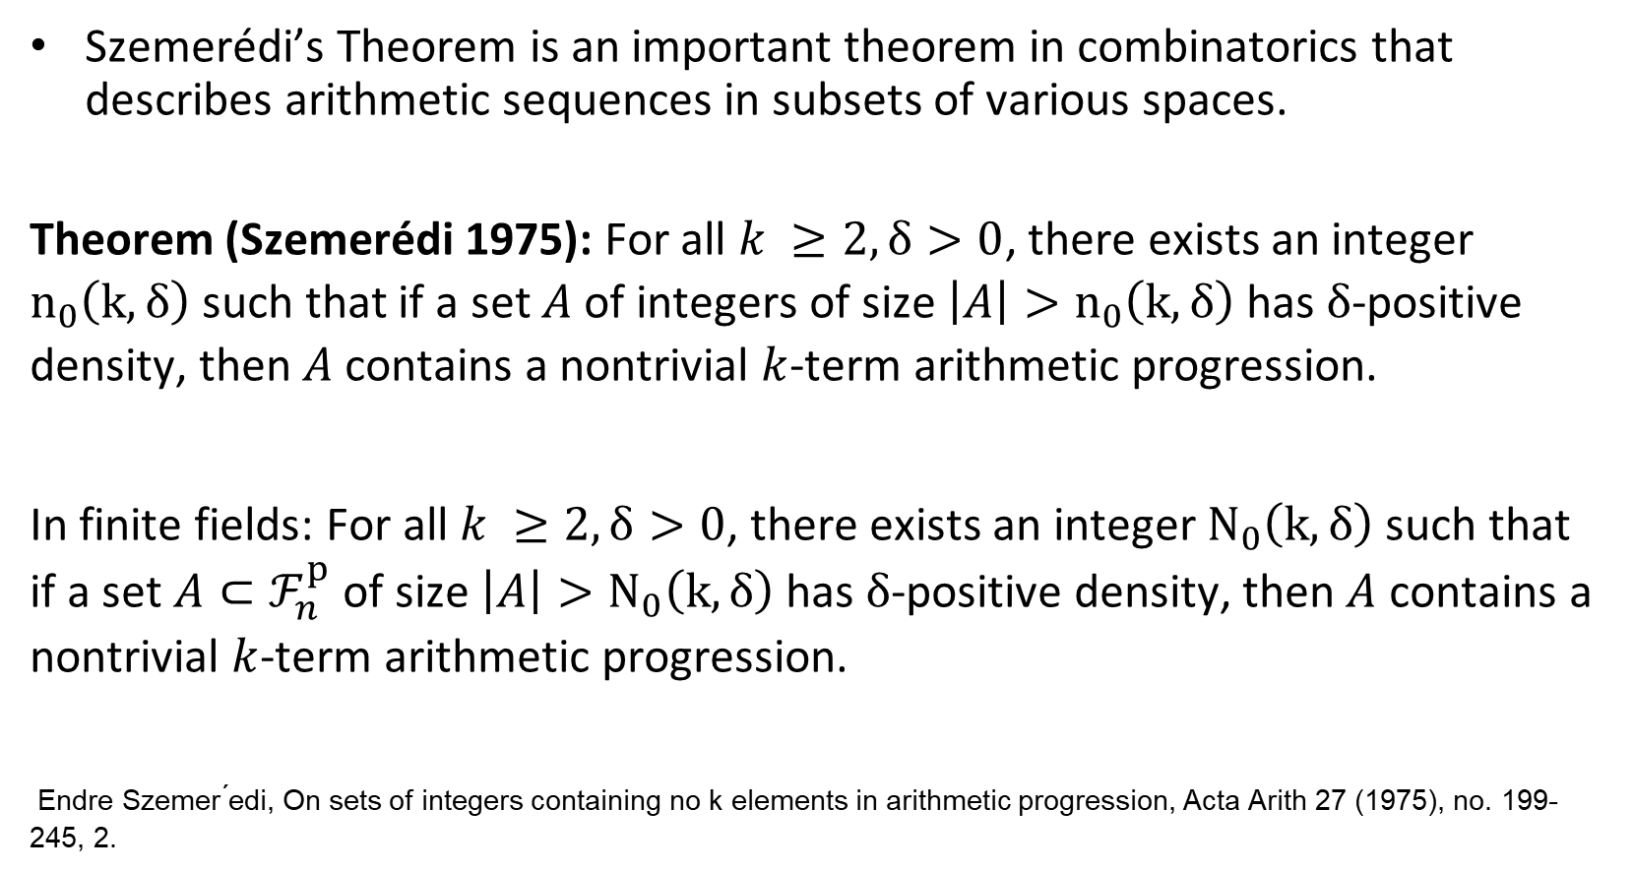
Background

Slide 6
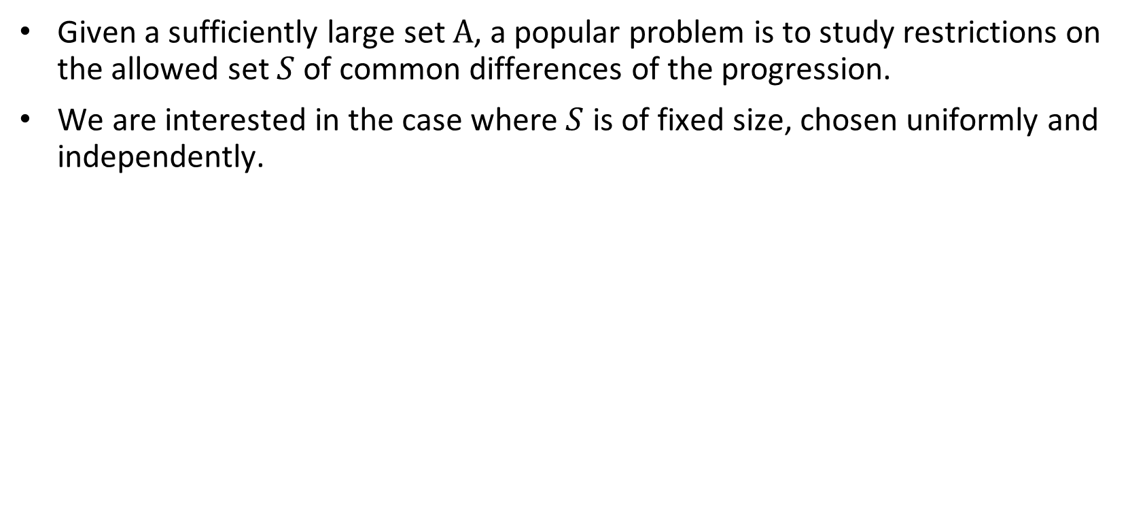
Background

Slide 7
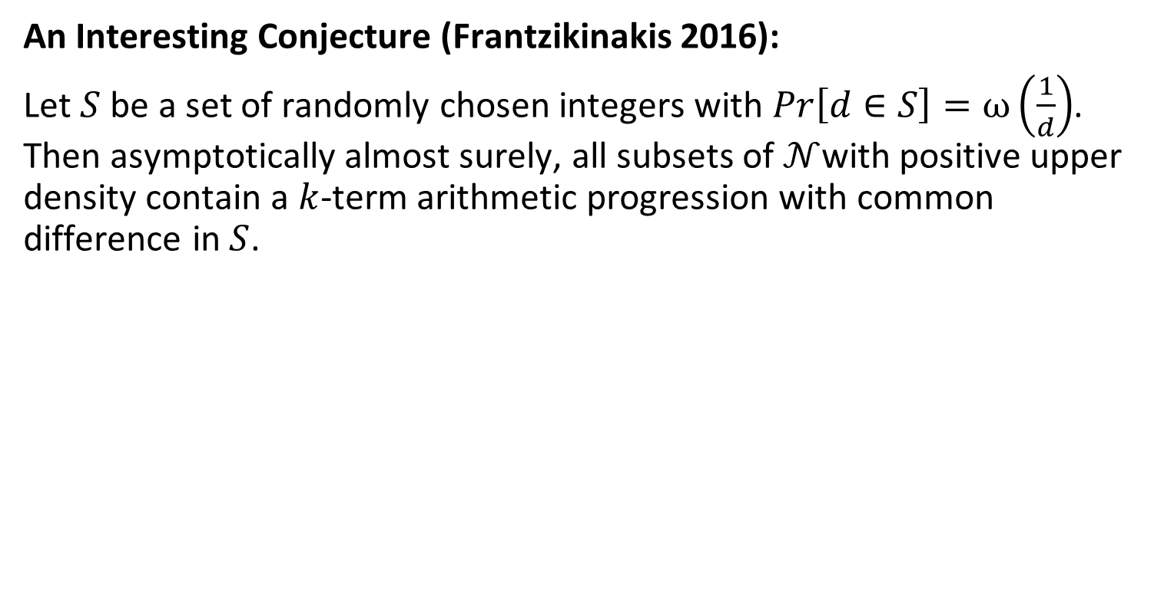
Background

Slide 8
Size of a Random Set
Jason Zheng
July 14, 2022

Slide 9
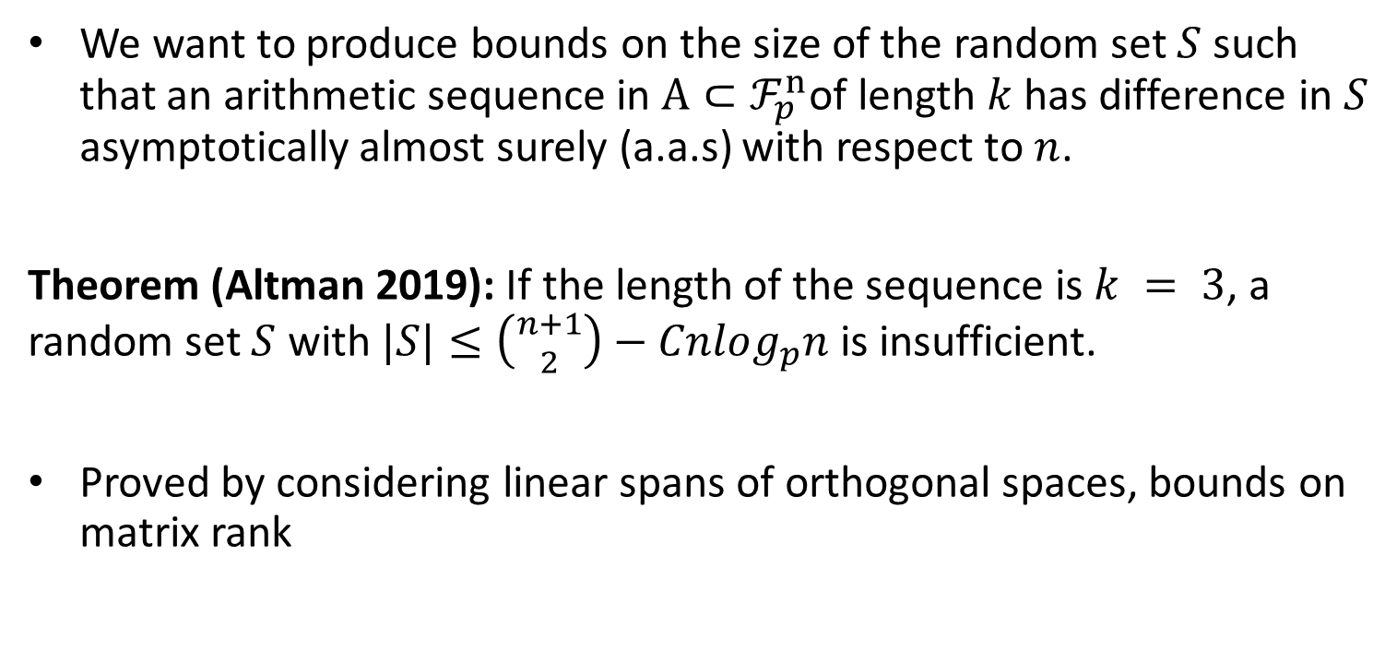
Size of a Random Set

Slide 10
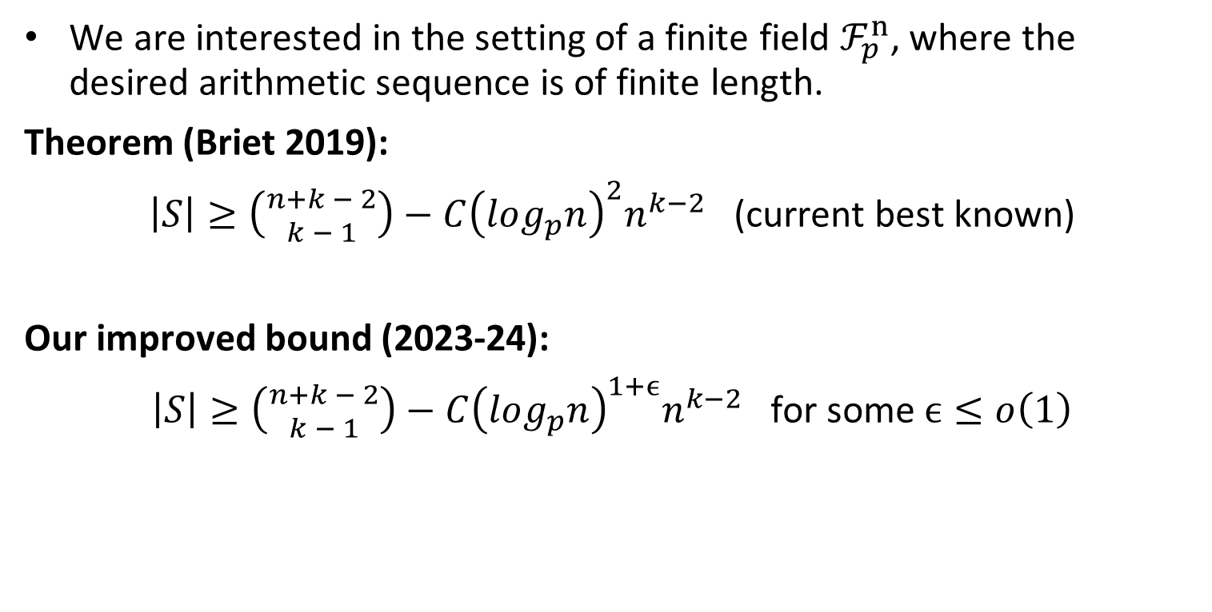
Size of a Random Set

Slide 11
Outline of Proof
Jason Zheng
July 14, 2022

Slide 12
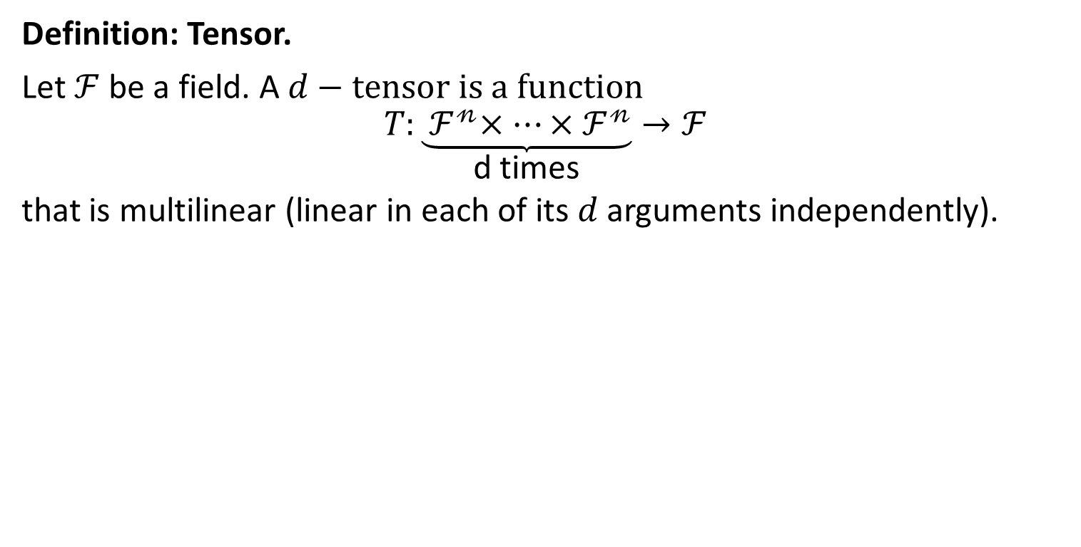
Tensors and Tensor Rank

Slide 13
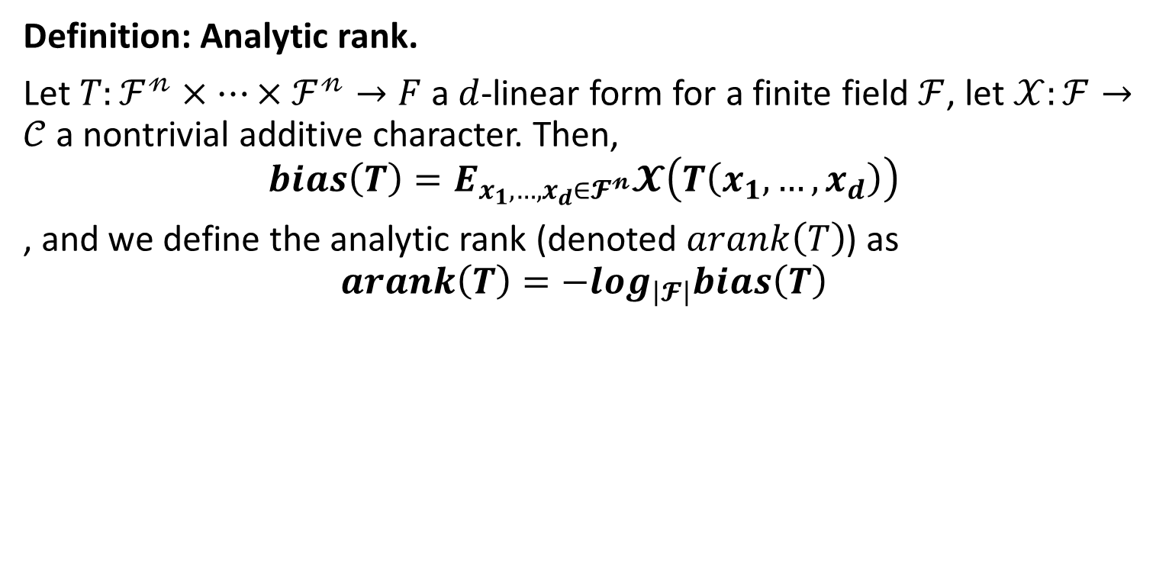
Tensors and Tensor Rank

Slide 14
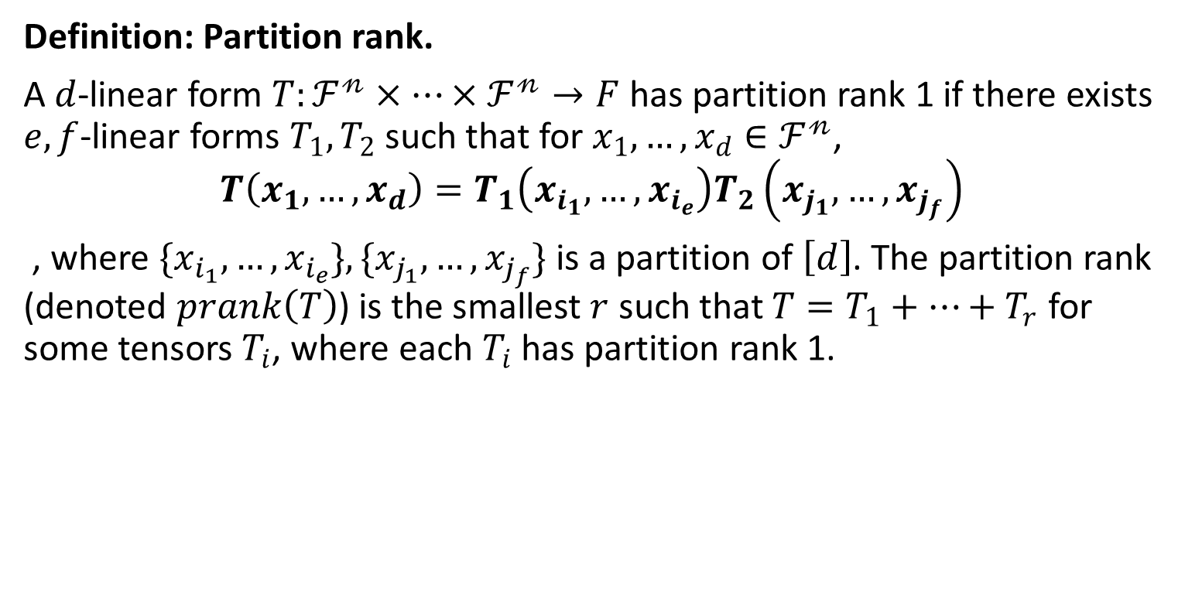
Tensors and Tensor Rank

Slide 15
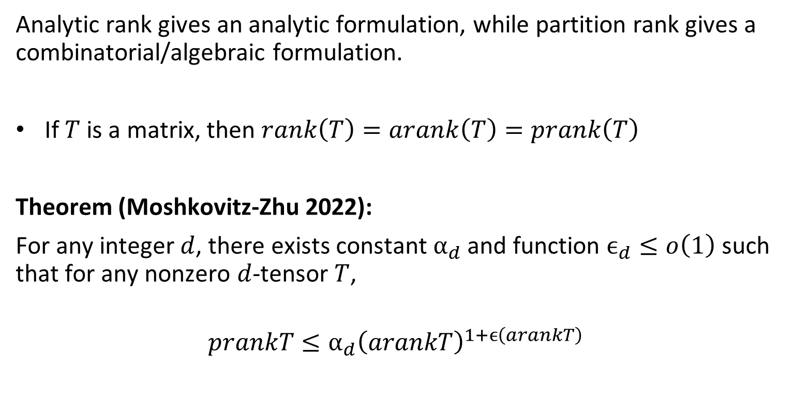
Tensors and Tensor Rank

Slide 16
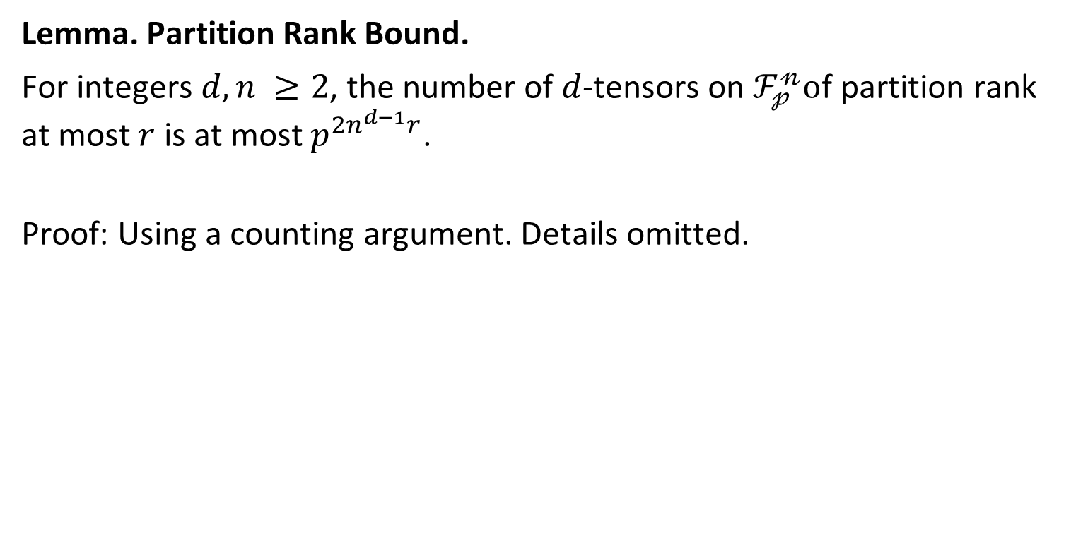
Tensors and Tensor Rank

Slide 17
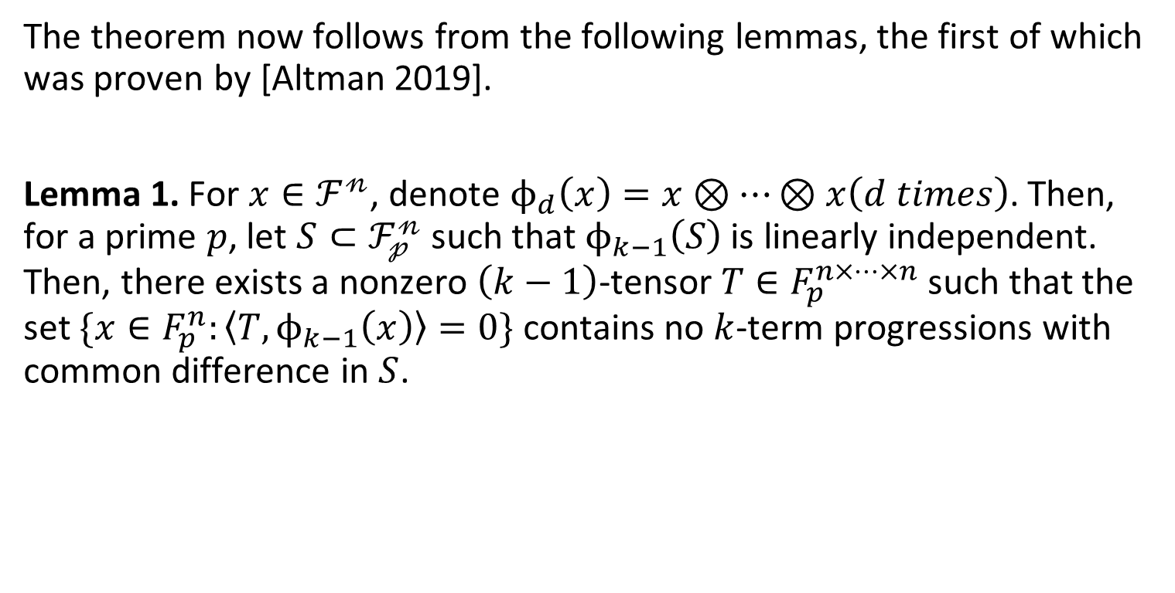
Proof of Theorem

Slide 18
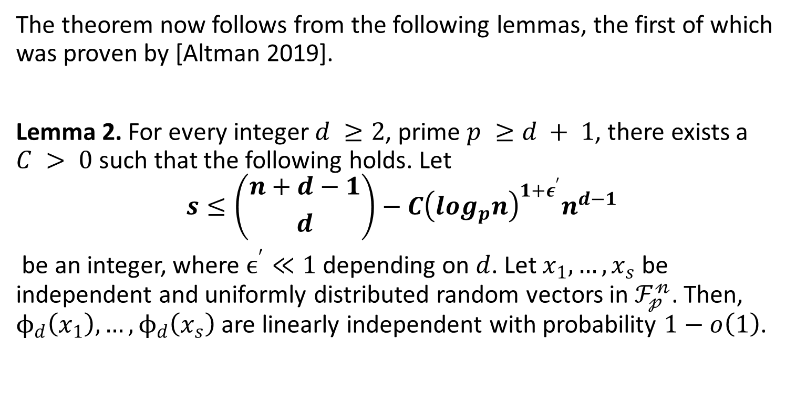
Proof of Theorem

Slide 19
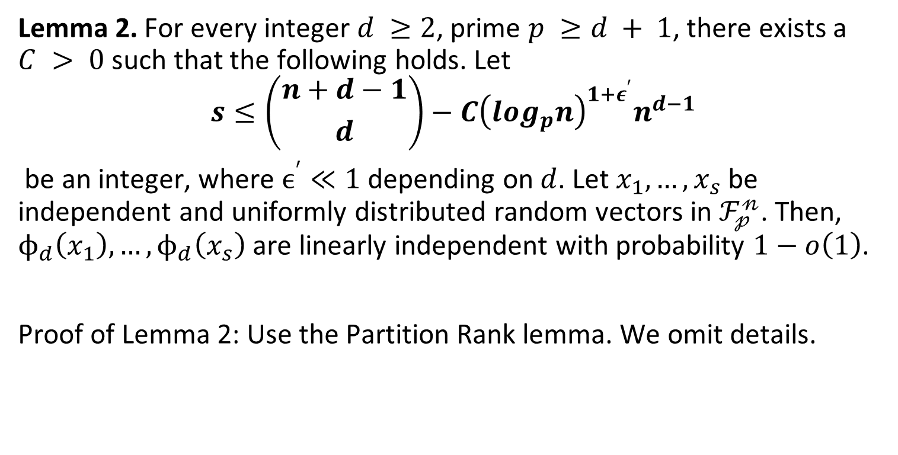
Proof of Theorem

Slide 20
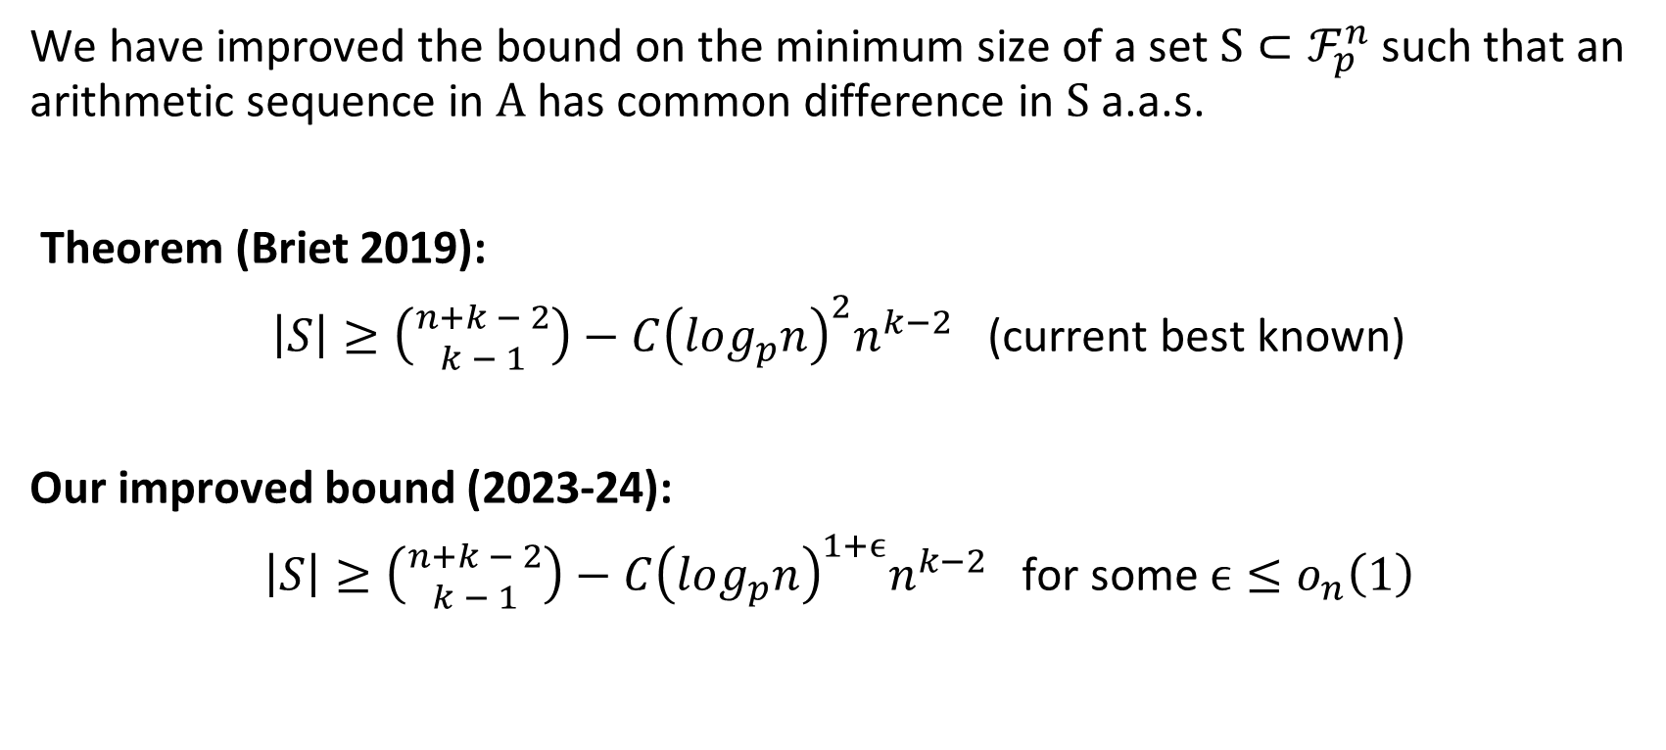
Conclusion

Slide 21
Szemerédi’s Theorem and Arithmetic Progressions with Differences from a Random Set
Jason Zheng
April 2024

